Slide 1


CUDA C/C++
Shrey Tiwari - 01FB16ECS368
Sumanth V Rao - 01FB16ECS402
Sumedh Basarkod - 01FB16ECS403
Suraj Aralihalli - 01FB16ECS405

Slide 2
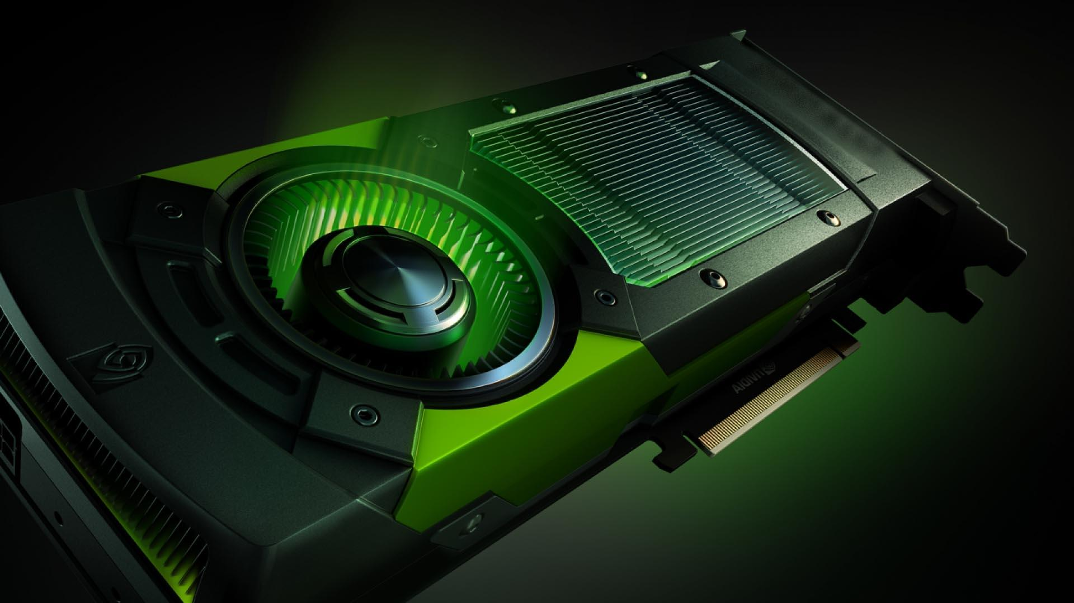
Introduction
May The GeForce Be With You...
CUDA − Compute Unified Device Architecture, is an extension of C programming, an API model for parallel computing
Created by Nvidia
GPGPU with nVidia graphics card
GPGPU is the process of using graphics card for non-graphics processing; “General Purpose Computing on a Graphics Processing Unit”

Slide 3


Slide 4
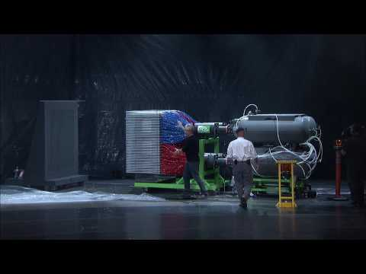

Slide 5
Introduction
CUDA − Compute Unified Device Architecture, is an extension of C programming, an API model for parallel computing
Created by Nvidia
GPGPU with nVidia graphics card
GPGPU is the process of using graphics card for non-graphics processing; “General Purpose Computing on a Graphics Processing Unit”

Slide 6
History of CUDA
Developer(s) - Nvidia Corporation.
Ian Buck led the launch of CUDA in 2006
Initial Release - June 23, 2007 ; 11 years
Stable Release - 10.0 / September 19, 2018 ; 59 days ago
Operating System - Windows, macOS, Linux
License - Freeware
Notes:
The first GPUs were designed as graphics accelerators, becoming more programmable over the 90s, culminating in NVIDIA's first GPU in 1999. Researchers and scientists rapidly began to apply the excellent floating point performance of this GPU for general purpose computing. In 2003, a team of researchers led by Ian Buck unveiled Brook, the first widely adopted programming model to extend C with data-parallel constructs. Ian Buck later joined NVIDIA and led the launch of CUDA in 2006, the world's first solution for general-computing on GPUs.
Since its inception, the CUDA ecosystem has grown rapidly to include software development tools, services and partner-based solutions. The CUDA Toolkit includes libraries, debugging and optimization tools, a compiler and a runtime library to deploy your application. You'll also find code samples, programming guides, user manuals, API references and other documentation to help you get started.

Slide 7
Why CUDA?
Ability to develop applications that can take advantage of high level of performance and scalability that GPUs architecture offer
Full support for integer and bitwise operations
Compiled code will run directly on GPU
Faster downloads and readbacks to and from GPU

Slide 8
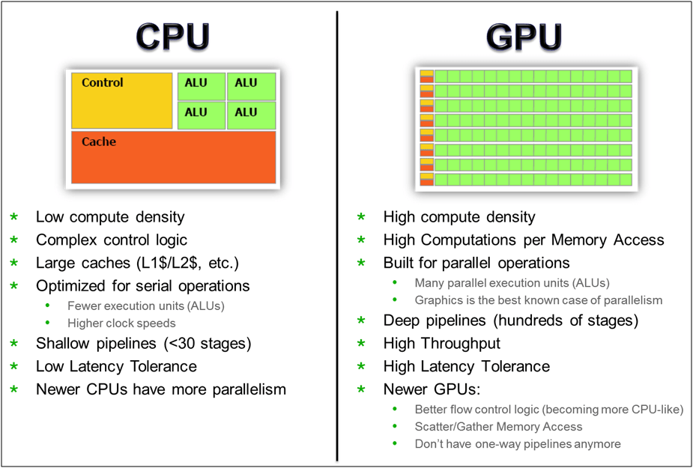
CPU vs GPU

Slide 9
CUDA C coding and compilation
Cuda C code is written into a text file and saved with a .CU extension. These files contain both cuda C and regular C++/C code. The extension tells the IDE that the code is to be passed to NVCC, the CUDA compiler
The CUDA compiler will compile all the CUDA code to PTX and send the remaining C++/C code back to the C++/C compiler.
The PTX code will be embedded into the EXE and compiled before running the application, IN this way PTX can be compiled to machine code that matches your specific device
Notes:
What is PTX?

Slide 10
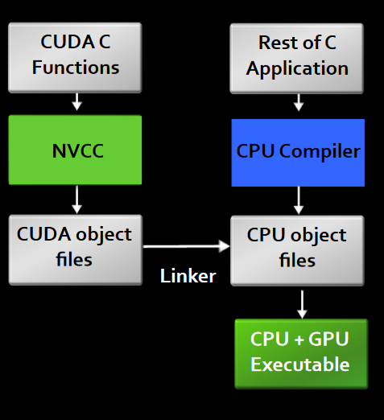
Compiling CUDA code

Slide 11
HOST and DEVICE
Host : This is the CPU. The system RAM, disks and other peripheral devices are all in the control of Host
Device : This is the GPU. It has its own RAM and cannot access system RAM, disks or other peripheral devices.

Slide 12
CUDA KERNELS
Kernel: Function that executes on GPU and can be called from host (CPU).
Can only access GPU memory
No variable number of arguments
No Static Variables
They are usually executed one by 100's or even 1000's of threads at a time.
They are written in CUDA C.The CPU launches the kernels with a special syntax to let the GPU know how many threads to be used.

Slide 13
FUNCTION QUALIFIERS
We designate Functions as Kernels by placing the function qualifiers before its name.
( So if we put global beside a function , now that’s a kernel)
1. __global__ Called by host, runs on GPU
2. __device__ Called by GPU, runs on GPU
3. __host__ (or no qualifier ) called by host , runs on host
These Qualifiers determine how functions are compiled.
Controls which compiler is used to compile functions

Slide 14
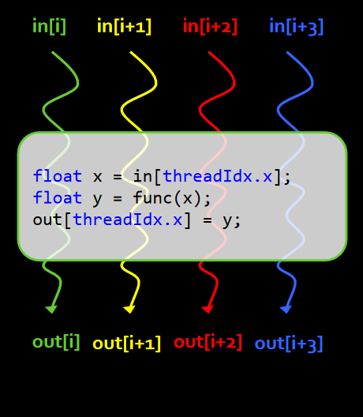
CUDA KERNELS: PARALLEL THREADS
A kernel is executed on the GPU as an array of parallel threads.
All threads execute the same kernel code but can take different paths
Each Thread has an ID
Select input/output data
Control Decisions

Slide 15
CUDA API Functions for Memory Management
cudaMalloc(void **devPtr, size_t sizeInBytes);
This function reserves memory on the GPUs on board Global memory.It takes one of the GPU's pointers as the first argument and size in bytes as second argument.
2. cudaFree(void **devPtr);
This function releases memory on the device previously allocated by cudaMalloc.The device has limited memory , So make sure free memory once you are done.

Slide 16
3. cudaMemcpy(void* dest, void* src, int SizeInBytes, enum direction);
This function could be used to copy data from device to host memory or host memory to device.
The direction is usually:
cudaMemcpyDeviceToHost
cudaMemcpyHostToDevice

Slide 17
CUDA THREAD ORGANIZATION
Programming a GPU is not similar to programming a CPU even though with CUDA C the code looks similar.
A CPU is a small collection of very powerful cores (run at GHz) where as a GPU is a large collection of only modestly powerful cores.( run at MHz)

Slide 18

THREADS
Single execution units that run kernels on the GPU.
GPUs can handle thousands of concurrent threads
CUDA programming model supports even more
Allows a kernel launch to specify more threads than the GPU can execute concurrently
Helps to amortize kernel launch times.

Slide 19
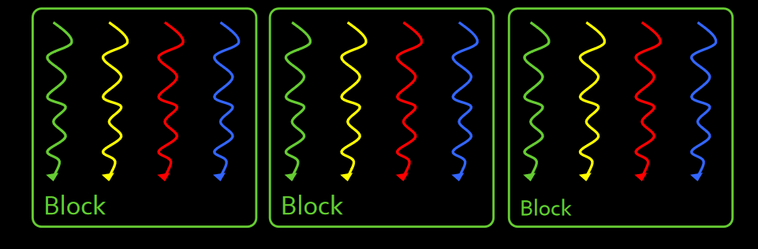
BLOCKS OF THREADS
Threads are grouped into blocks.

Slide 20
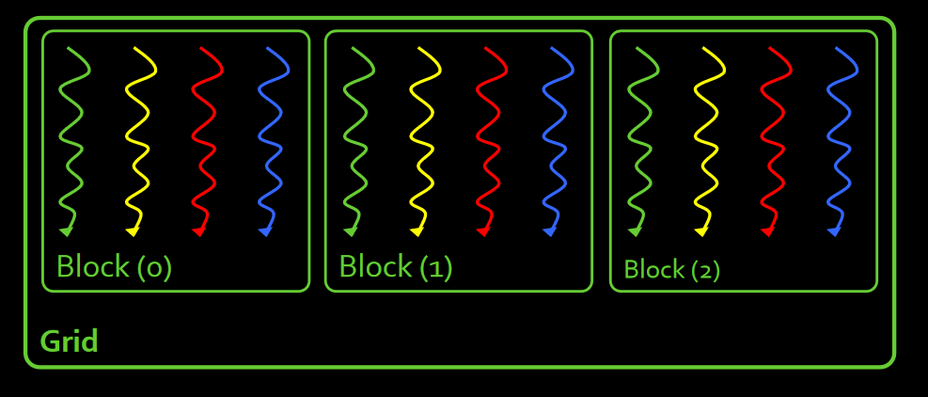
GRIDS OF BLOCKS
Blocks are grouped into a grid.
A kernel is executed as a grid of block of threads.

Slide 21
WHY BLOCKS AND THREADS ?
You may be wondering why not just say launch 67 million threads instead of organising into blocks.
Each GPU has a limit on the number of threads per block but no limit on the number of blocks.Each GPU can run some number of blocks concurrently, executing some number of threads simultaneously
By adding the extra level of abstraction, higher performance GPU's can simply run more blocks concurrently and chew through the work load quicker with absolutely no change to the code

Slide 22
Dim3 DATA TYPE
Dim3 is a 3d Structure or vector type with three integers x, y and z. You can initialize as many of the three coordinates as you like
dim3 threads(368); Initialize with x as 368, y and z will be 1
dim3 blocks(402,403); Initialize with x and y , z will be 1
dim3 grid(405,405,405);

Slide 23
EACH THREAD IS INDIVIDUAL
Each of the running threads is individual, they know the following
threadIdx - Thread index within the block
blockIdx - Block index within the grid
blockDim - Block dimensions in threads
gridDim - Grid dimensions in blocks
Each of these are dim3 structures and can be read in the kernel to assign particular workloads to any thread.

Slide 24
KERNEL INVOCATION
The host calls a kernel using triple chevron <<< >>>.In the chevrons we place the number of blocks and number of threads per block.
someKernel <<< 100,256 >>> (...);
This would launch 100 blocks of 256 threads each i.e 25600 threads in total.
You can also launch kernels with 3d grids and blocks.

Slide 25
EXAMPLE
Its common to have threads calculate a unique id within the kernel to process some specific data.If we launch a kernel with:
Somekernel <<< 100,25 >>> (...);
Inside the kernel, each thread can calculate a unique id with:
int id= blockIdx.x * blockDim.x + threadIdx.x
So the 5th thread of the 4th block would calculate:
int id= 4*25 + 5 = 105
This will end up to be unique to every thread.

Slide 26
Simple Processing Flow

Slide 27
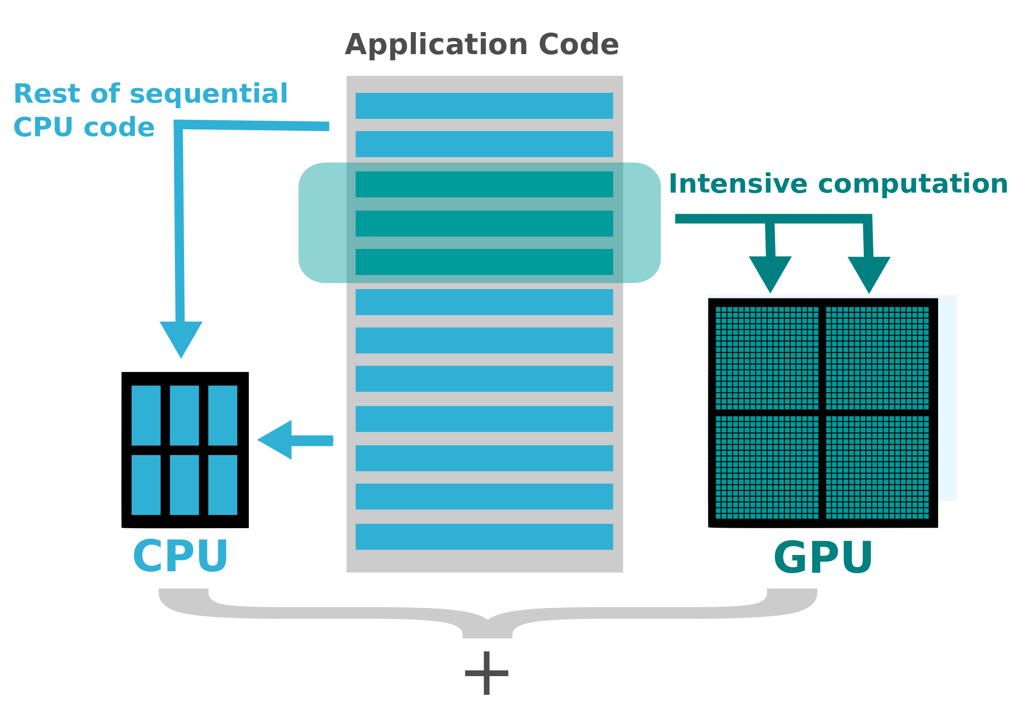

Slide 28
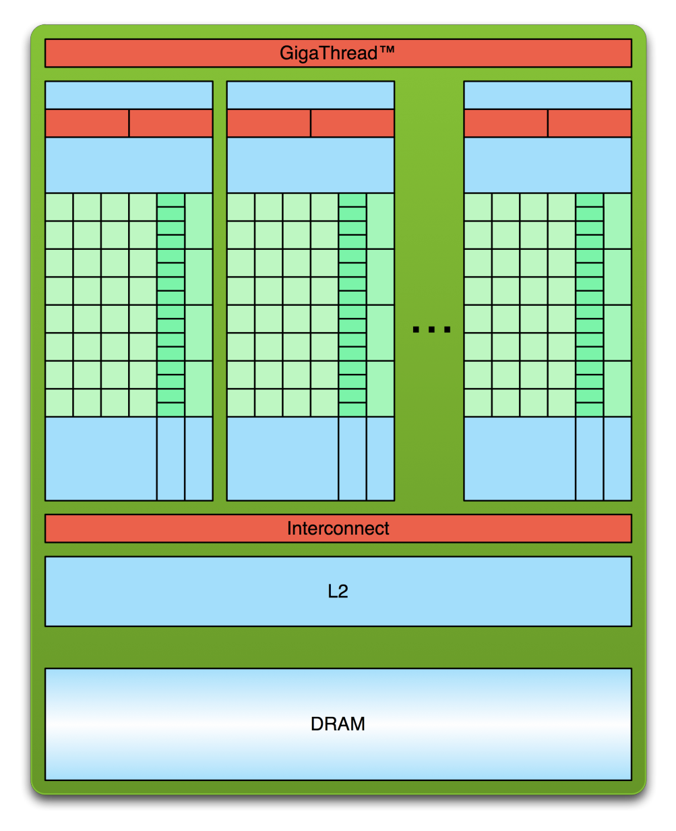
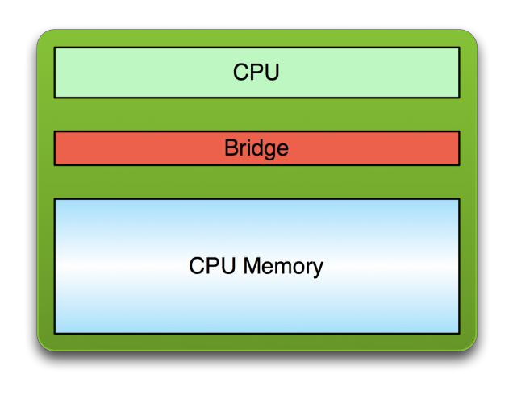
PCI Bus
Copy input data from CPU memory to GPU memory

Slide 29
PCI Bus
Copy input data from CPU memory to GPU memory
Load GPU code and execute it, caching data on chip for performance

Slide 30
PCI Bus
Copy input data from CPU memory to GPU memory.
Load GPU program and execute, caching data on chip for performance.
Copy results from GPU memory to CPU memory.

Slide 31
Let’s Talk Hardware

Slide 32
Memory
The GPU and CPU do not share the same address space.
Data must be copied back and forth between device and host.
Memory is biggest bottleneck and future we can expect to see shared memories.

Slide 33
Memory Types
Global
Large and accessible throughout.
Slow.
Local
Used during register spilling.
Slow.
Scope is limited to thread.
Cache (L1 and L2)
L1 is cache per multiprocessor.
L2 is shared across all multiprocessors.

Slide 34
Memory Types (cont.)
Constant
Small and fast.
CPU sets the values.
Constant.
Shared
Very fast.
Very small.
Part of L1 cache.
Registers
Large in number.

Slide 35
CUDA API Functions
cudaMalloc(void **DevicePointer, int SizeInBytes)
cudaFree(void **DevicePointer)
cudaMemcpy(void *Dest, void *Src, int SizeInBytes, enum Direction)
Direction can take two values:
CudaMemcpyDeviceToHost
CudaMemcpyHostToDevice

Slide 36
Race Conditions
When two threads change the same variable in shared memory.
Synchronisation is achieved using:
__Syncthreads()
Very hard to detect due to massive parallelism.

Slide 37
RECAP
What have we learned?
Write and launch CUDA C/C++ kernels
global, <<<>>>, blockIdx, threadIdx, blockDim
Manage GPU memory
cudaMalloc(), cudaMemcpy(), cudaFree()
Manage communication and synchronization
shared, __syncthreads()

Slide 38
Example Demo

Slide 39
QUIZ
(FASTEST HAND FIRST)

Slide 40


INTRODUCING

Slide 41
QUESTION 1
A kernel is launched as a ______?
A block of grid of threads.
A thread of block of grids.
A grid of block of threads
None of these

Slide 42
ANSWER 1
A kernel is launched as a ______?
A block of grid of threads.
A thread of block of grids.
A grid of block of threads
None of these

Slide 43
QUESTION 2
A kernel is launched with the following config:
SomeKernel <<< 125,4 >>>(......)
What is the id of the 2nd thread of the 100th block?

Slide 44
ANSWER 2
125 blocks with 4 thread per block.
int id= blockIdx.x * blockDim.x + threadIdx.x
Id = 100* 4 + 2
= 402

Slide 45
QUESTION 3
The function qualifier __global__ is
A)Called by host, runs on GPU
B)Called by GPU, runs on host
C) Called by host, runs on host
D) Called by GPU, runs on GPU

Slide 46
ANSWER 3
The function qualifier __global__ is
A)Called by host, runs on GPU
B)Called by GPU, runs on host
C) Called by host, runs on host
D) Called by GPU, runs on GPU

Slide 47
QUESTION 4
Which statement is true?
Cuda C/C++ is directly converted into hardware language
Cuda C/C++ is converted into pseudo-assembly language PTX first.
Cuda is a High-Level language and does not need hardware support.
Cuda nvcc compiler directly generates binary code.

Slide 48
ANSWER 4
Which statement is true?
Cuda C/C++ is directly converted into hardware language
Cuda C/C++ is converted into pseudo-assembly language PTX first.
Cuda is a High-Level language and does not need hardware support.
Cuda nvcc compiler directly generates binary code.

Slide 49
Questions?

Slide 50
THANK YOU

Slide 51

CUDA C/C++
CUDA C/C++
Shrey Tiwari - 01FB16ECS368
Sumanth V Rao - 01FB16ECS402
Sumedh Basarkod - 01FB16ECS403
Suraj Aralihalli - 01FB16ECS405
Suraj Aralihalli
Sumedh Pb
Sumanth V Rao
Under guidance of Guruji : Prof. Shrey mt

